Slide 1
Employee Data Analysis using Excel
STUDENT NAME: RENUKA DEVI.K
REGISTER NO :3122161119 AND 55B09E494DE6F5A9A21483C688D04AFB
DEPARTMENT :B.COM Accounting and Finance
COLLEGE :Shri Shankarlal Sundarbai Shasun jain College for women

Slide 2
PROJECT TITLE
Employee Performance Analysis using Excel

Slide 3


AGENDA
Problem Statement
Project Overview
End Users
Our Solution and Proposition
Dataset Description
Modelling Approach
Results and Discussion
Conclusion
3/21/2024 Annual Review

Slide 4

PROBLEM STATEMENT
The performance analysis of each employee is important to identify the best employee and give appraisal and also to identify the least performing employee and motivating them to do more better.By this ,the company can easily track and make decisions and corrective actions.

Slide 5

PROJECT OVERVIEW
Analysing the performance level of employees
considering various factors like gender, performance
score, ratings, achievements and their contribution to
the company. By this way we will be able to know how
many employees are well-versed in their work and who
needs improved, so that they can be motivated. This
states the employees contribution level..

Slide 6
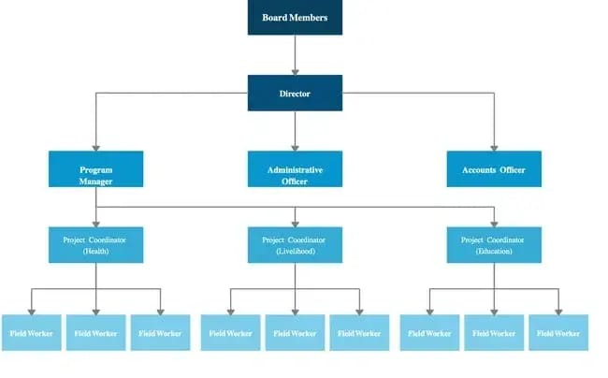

WHO ARE THE END USERS?
The end users of employee performance analysis in human resources include:
Managers and team leaders
These are the power users of performance management systems, as they are directly responsible for their reports. They usually conduct performance reviews, as they know their employees' roles and work best..

Slide 7

OUR SOLUTION AND ITS VALUE PROPOSITION
Conditional formatting -to highlight missing values.
Filter -to remove those blanks/highlighted values.
Formula-IFS formula has been used to set the performance level.
Pivot table-to give a summary .
Graph-to understand the analysis easily.

Slide 8
Dataset Description
•Employees - IBM EDUNET
•Available features - 26
•Considered features - 9
1. Emp ID - Numeric
2. First Name - Text
3. Last Name - Text
4. Employee Type
5. Gender - Male/Female
6. Performance score
7. Employee Rating - Numeric
8. Business Unit
9. Employee Status

Slide 9

THE "WOW" IN OUR SOLUTION
Additional features are
Performance level=IFS (Z2>=5"VERY HIGH",Z2>=4"HIGH","Z2>=3"MED",TRUE",LOW")
3/21/2024 Annual Review

Slide 10
MODELLING
Data collection
1.Data set from edunet Dashboard
Features collection
Collected 26 features from dataset
Only 9 features from dataset
1. Emp id-numeric
2. First name-text
3. Last name-text
4.Employee type
5.Gender-male/female
6.Performance score
7. Employee rating - numeric
8.Business unit
9. Employee status

Slide 11
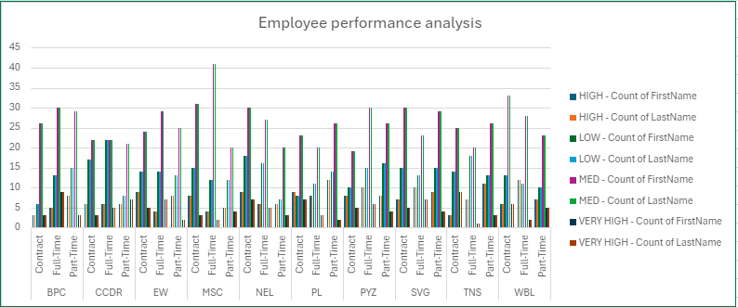
RESULTS

Slide 12
conclusion
And hence it is concluded that the MSC with full time is higher than compared to other departments

